Slide 1
Electricity Billing and Paying System
A Swing-JDBC Application
Made by Gaurav Sachdeva

Slide 2
Introduction
Electricity Bill Generating and Paying System is an application on Windows-OS Platform made by using Java Swing for Bill Generation and Paying Electricity Bills by Merchants and Admins.

Slide 3
Frontend and Backend
Front End Development: Swing Framework.
Back End Development: Java, JDBC, MySQL Database System.

Slide 4
Screenshots

Slide 5
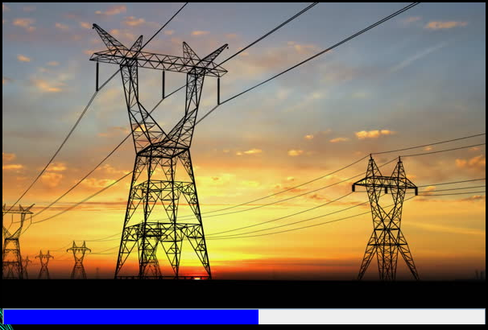
Initialising Page

Slide 6
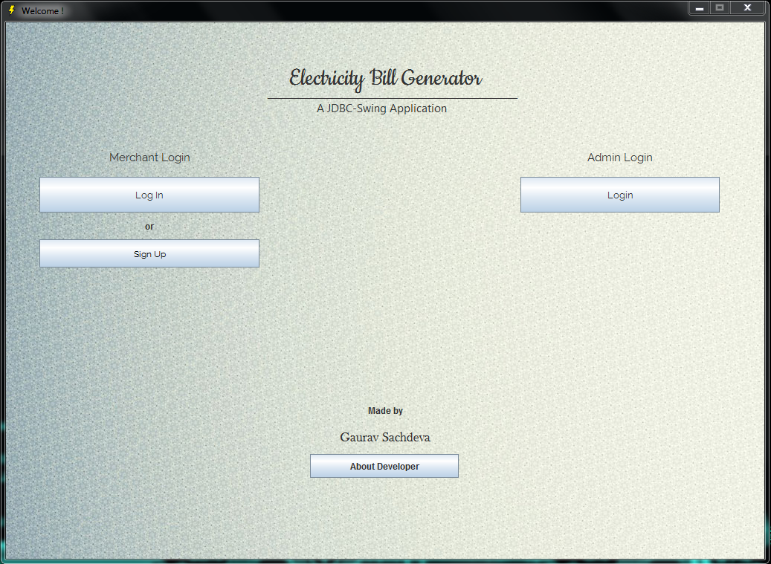
Login Page

Slide 7
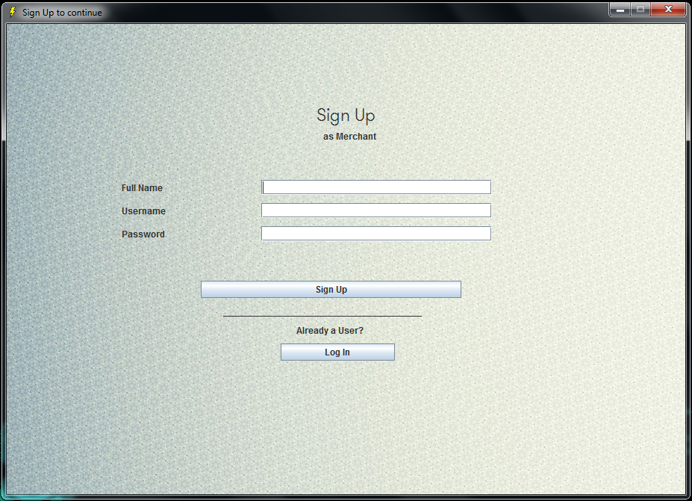
Sign Up Page (Merchant)

Slide 8
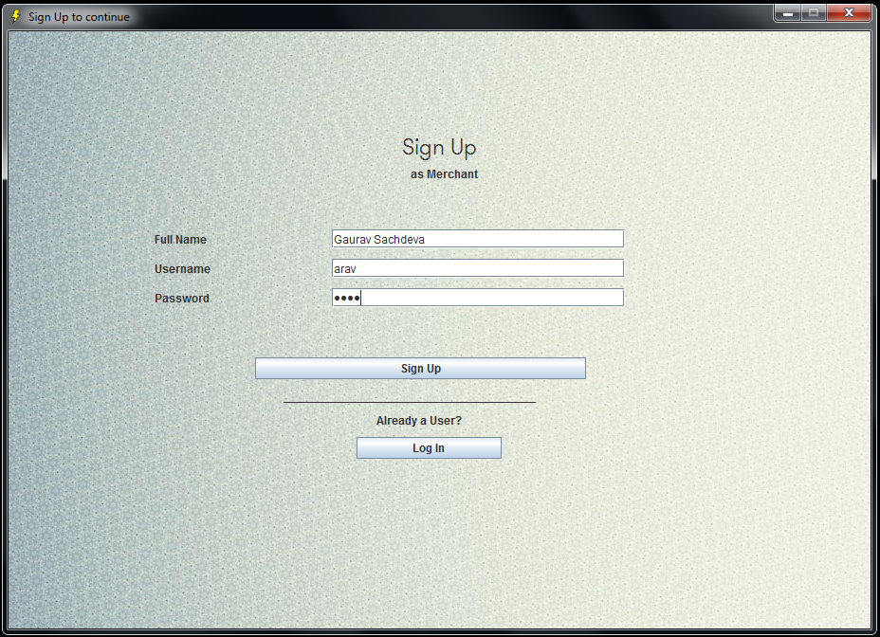
Sign Up Page (After adding values)

Slide 9
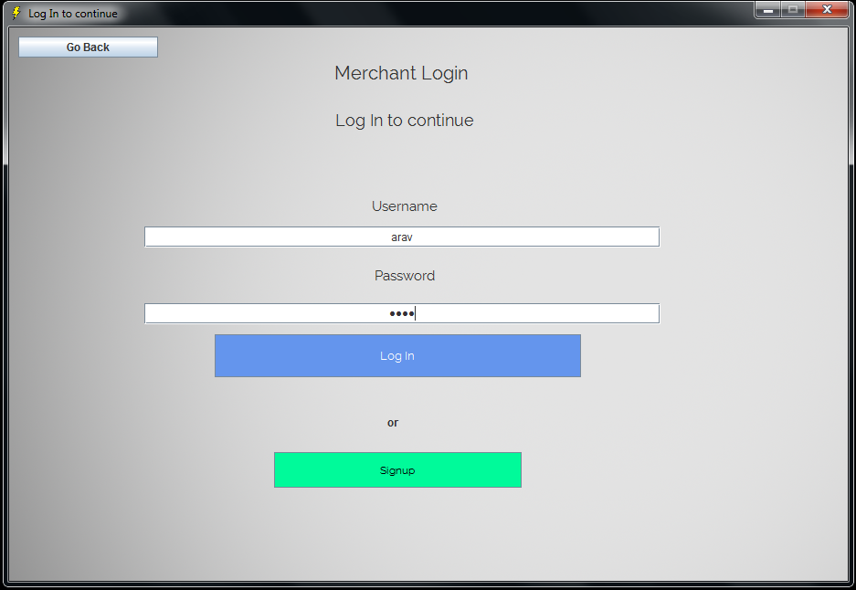
Login Page (Merchant Login)

Slide 10
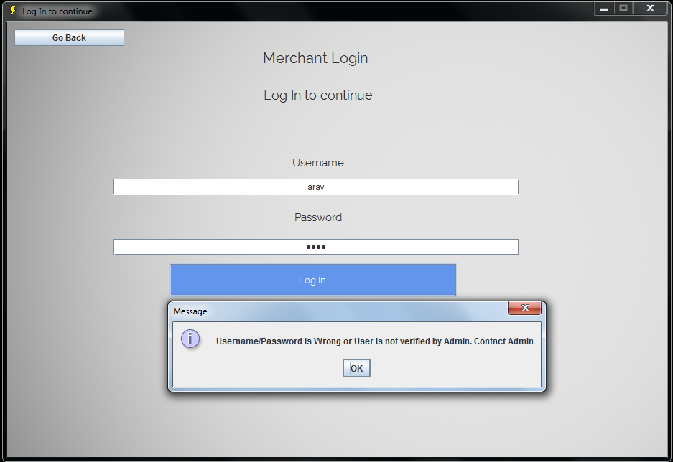
Login Failed

Slide 11
Need Verification by Admin

Slide 12
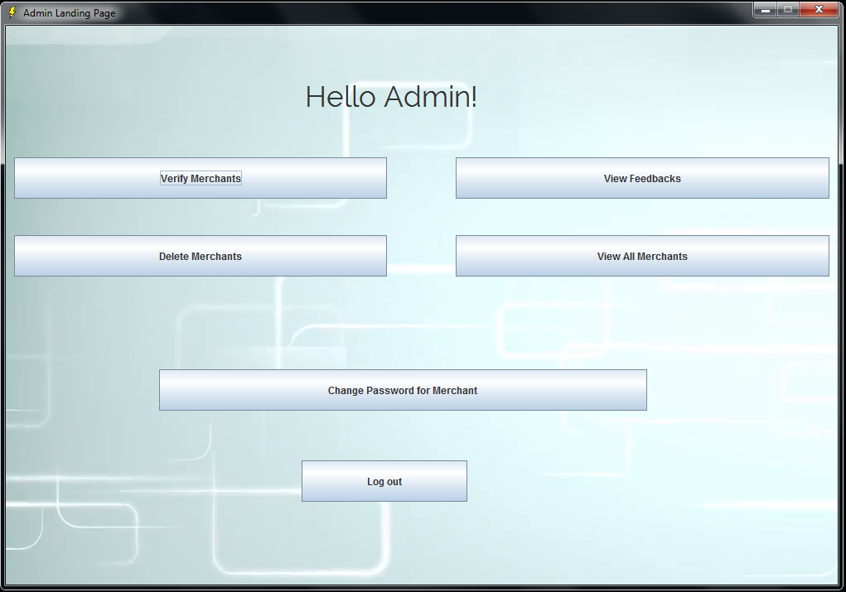
Verify Merchants

Slide 13
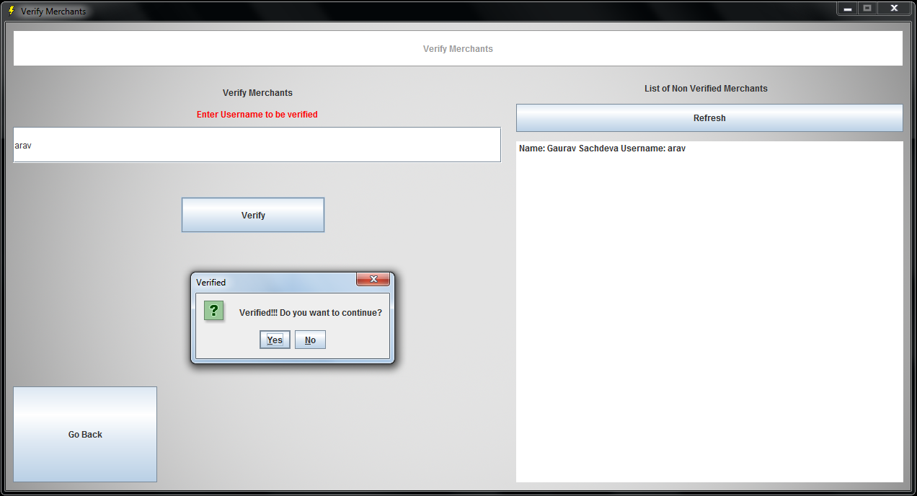
Enter username and click on Verify
By clicking here you can get List of non-verified users

Slide 14
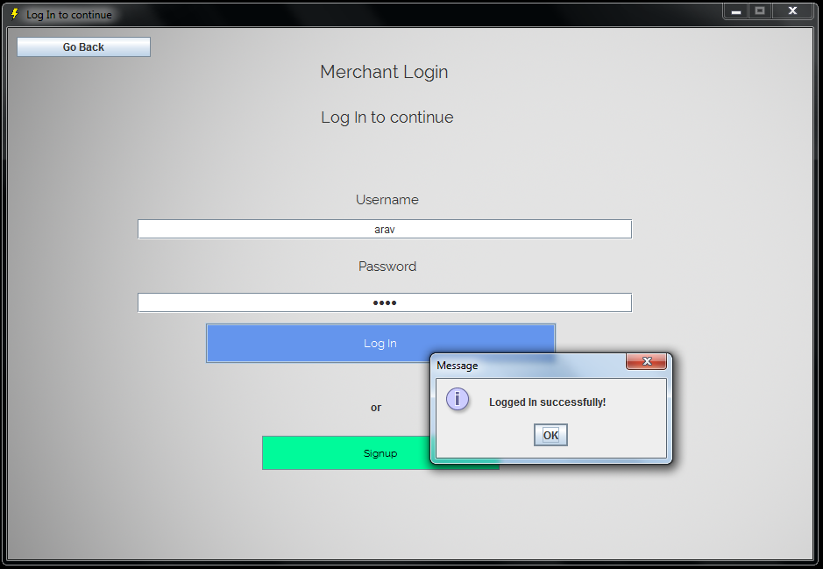
Now Merchant can Login

Slide 15
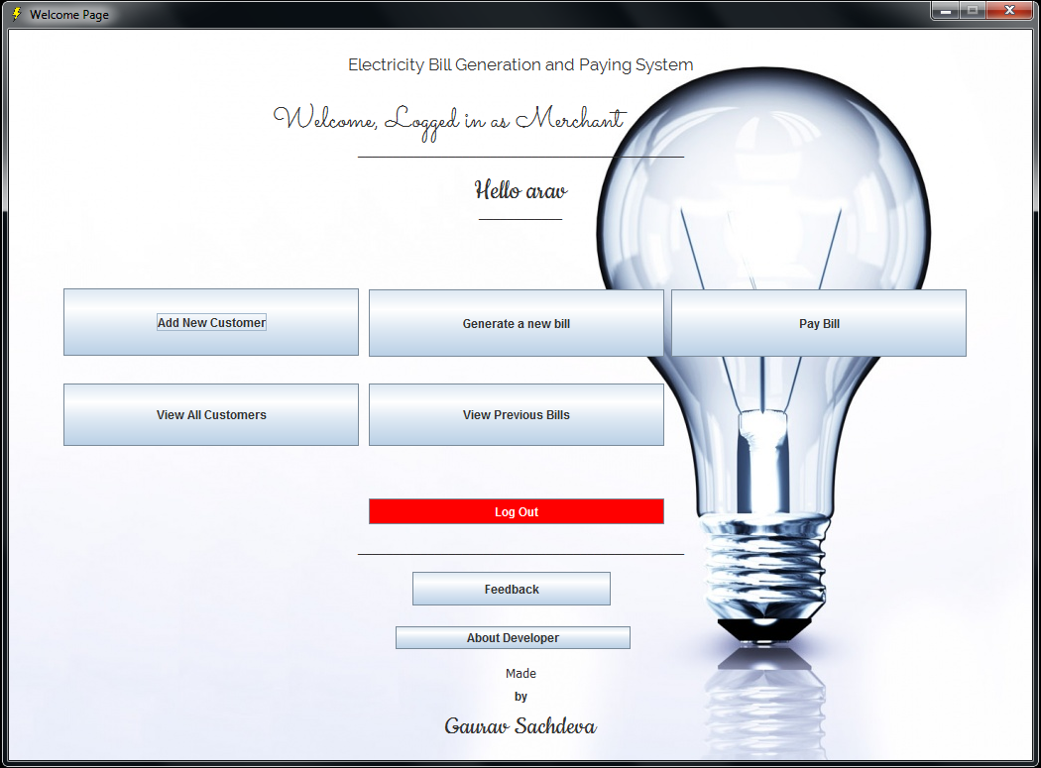
Add New Customer

Slide 16
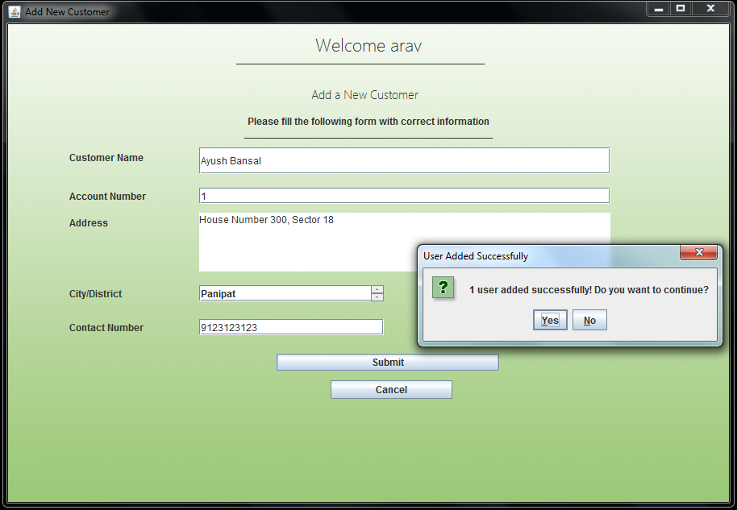
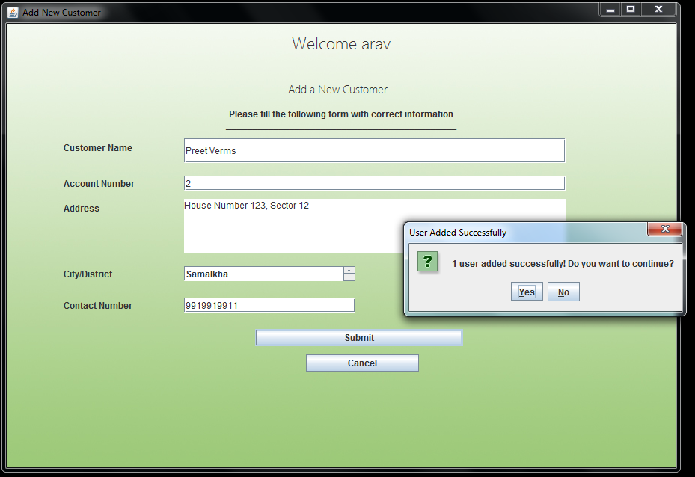
Adding Information for New Customers

Slide 17
Now Click on Generate a New Bill

Slide 18
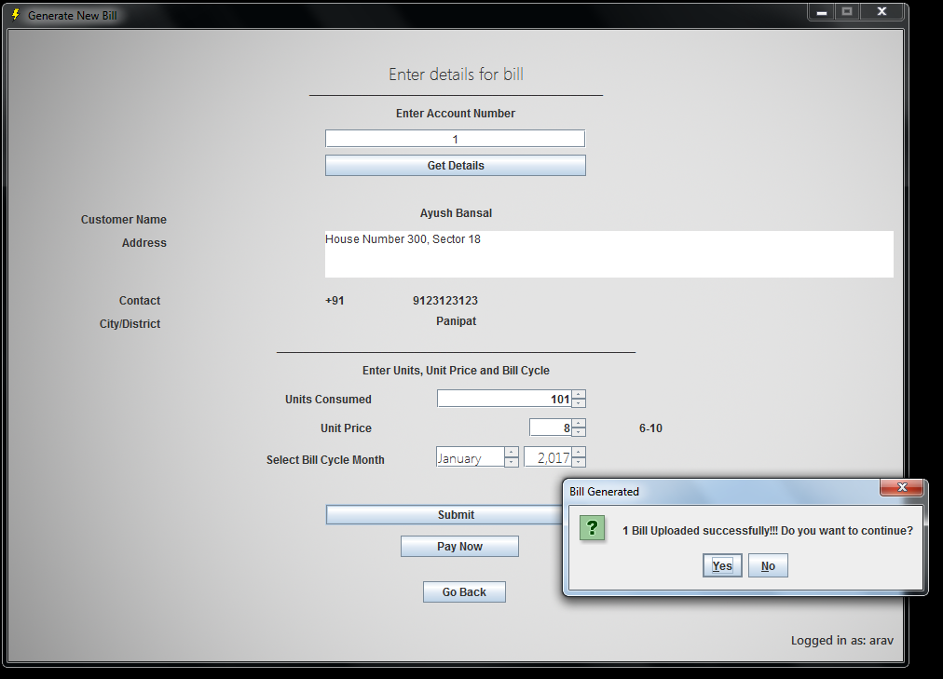
Type Account Number and Click on Get Details
Then Enter Units Consumed, Unit Price and Bill Cycle

Slide 19
You can Pay Bill from here

Slide 20
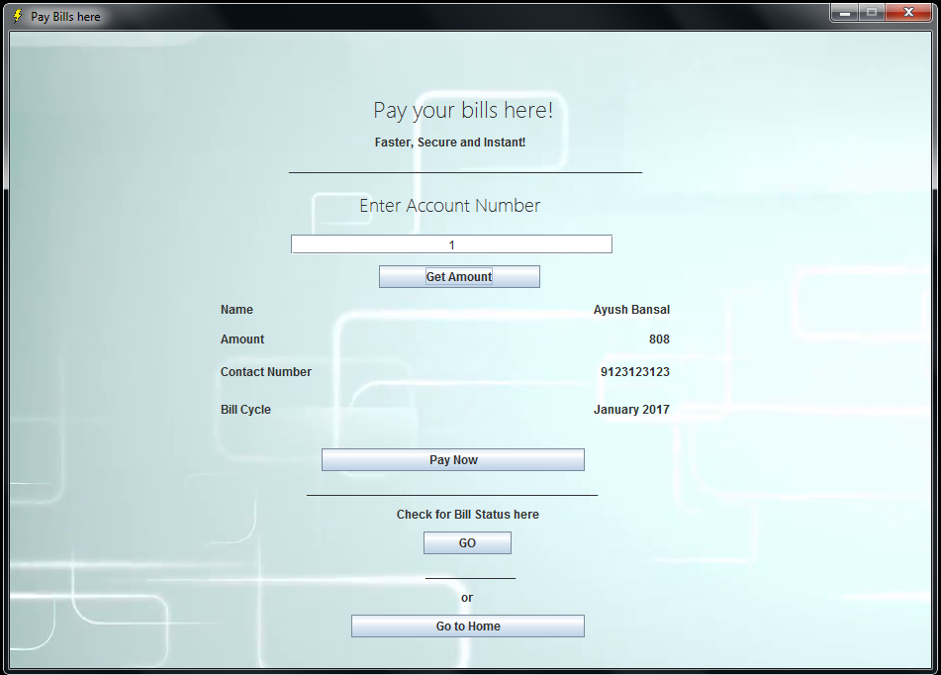
Just enter account number and click on Get Amount
And then on Pay Now

Slide 21
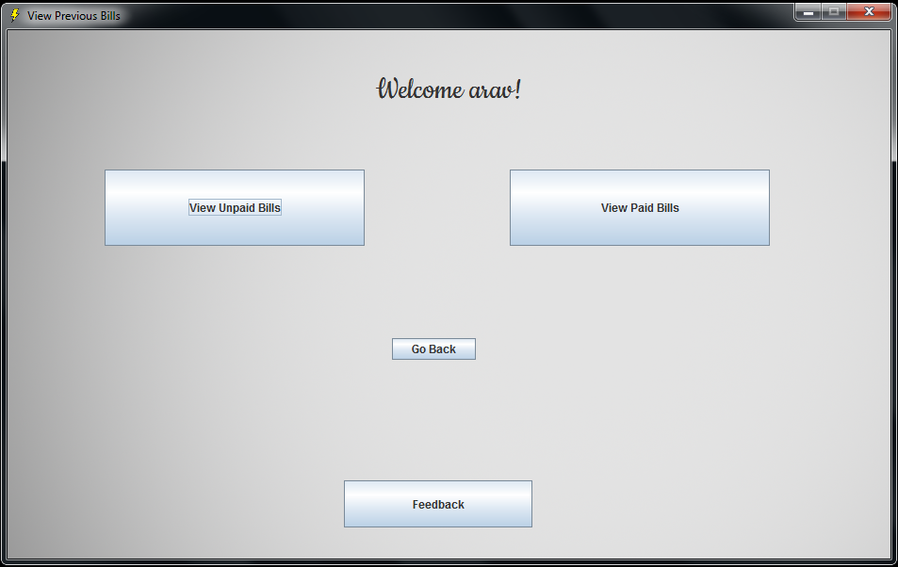
You can check old bills with Paid and Unpaid Status

Slide 22
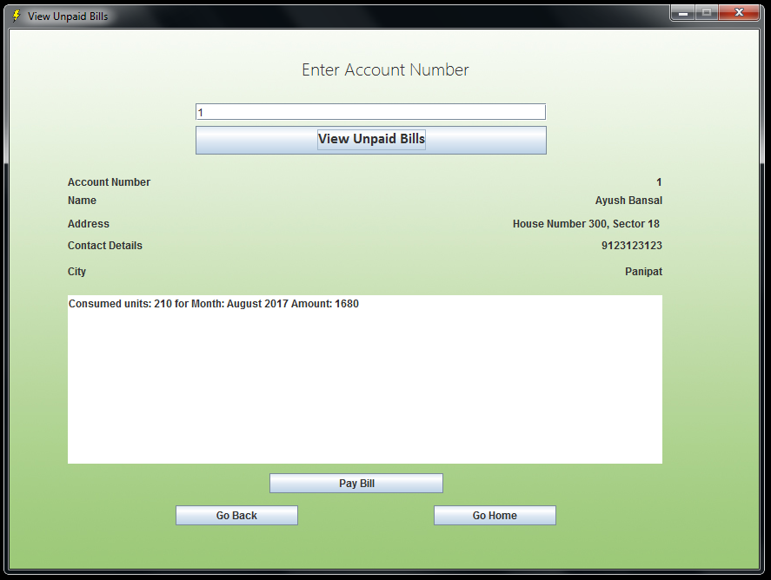
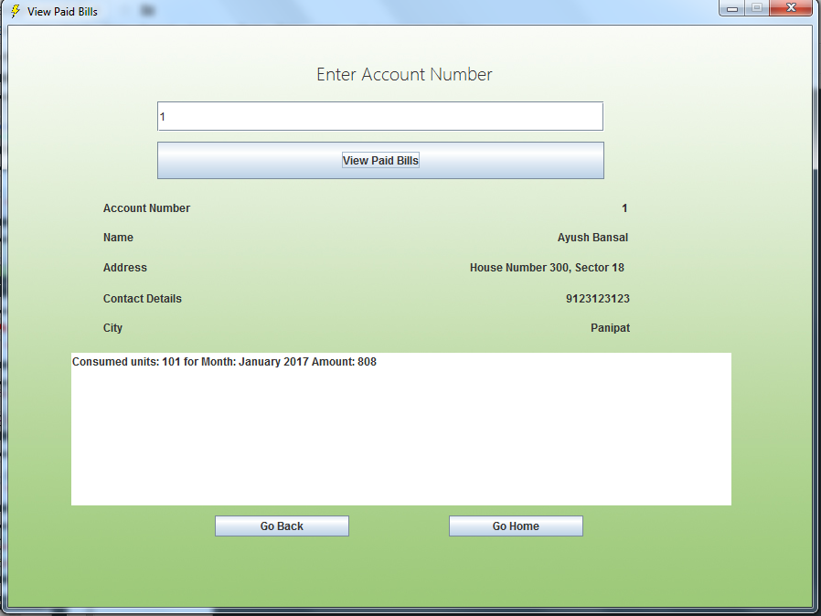
You can check Unpaid Bills here
And Paid Bills here

Slide 23
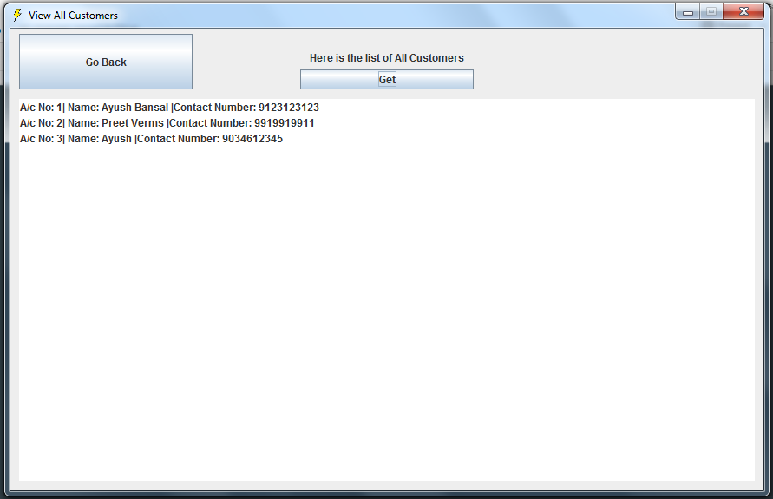
Merchant can View All Customer Info from View All Customers Menu on Landing Page

Slide 24
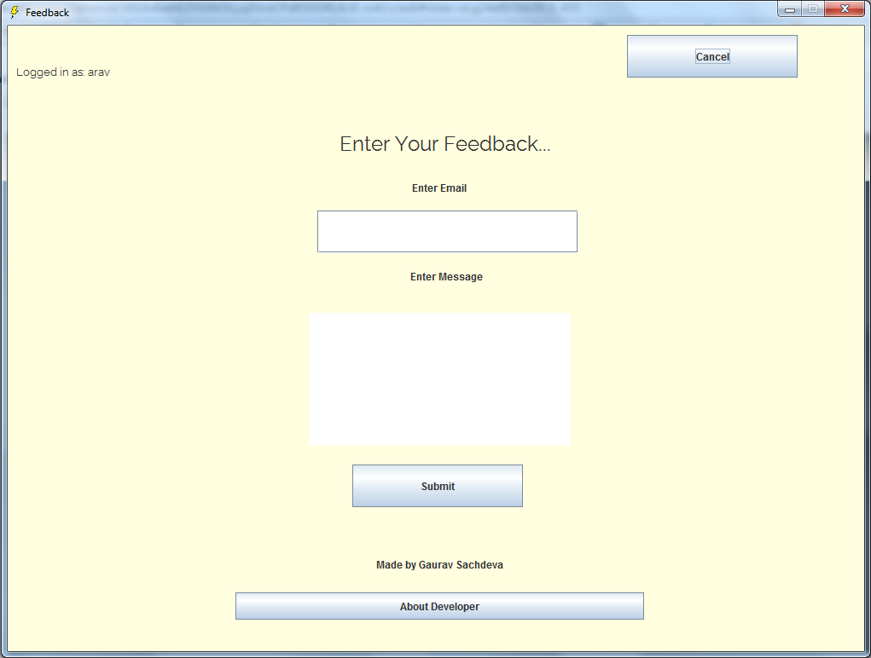
Please give me feedback on Feedback Page

Slide 25
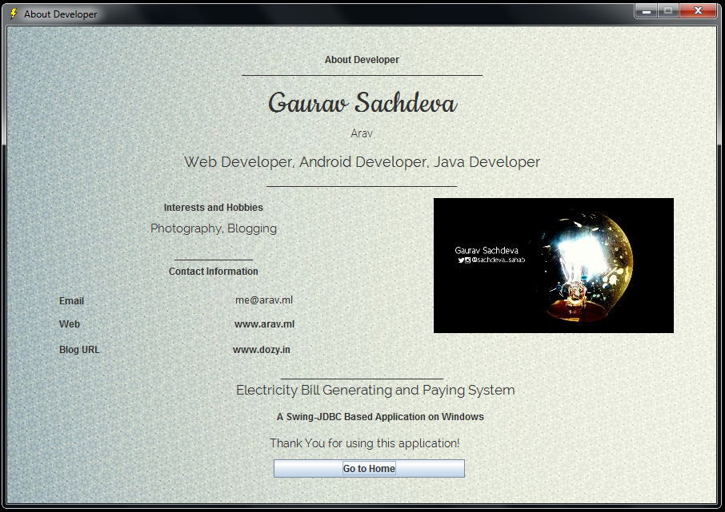
About Developer

Slide 26
Thank You!
Made by
Gaurav Sachdeva

